Slide 1
클라우드 컴퓨팅

Slide 2
목차
Machine Virtualization Overhead
Docker? Container?
Class Roadmap
Setting
Alpine Linux
Docker
Build
Run
Isolation
Assignment 1

Slide 3
Machine Virtualization Overhead
Guest
OS
Guest
OS
Guest
OS
Virtualized
Infrastructure
Virtualized
Infrastructure
Virtualized
Infrastructure
Hypervisor
Infrastructure
Notes:
인프라를 가상화 시키고 그 위에 다시 커널을 올려야 해?
기존의 인프라를 그대로 사용하게 해주면 안되?

Slide 4
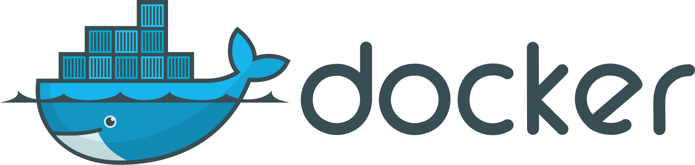
Container? Docker?

Slide 5

Container? Docker?

Slide 6
Container? Docker?
chroot
A chroot on Unix operating systems is an operation that changes the apparent root directory for the current running process and its children. A program that is run in such a modified environment cannot name (and therefore normally cannot access) files outside the designated directory tree. The modified environment is called a chroot jail.
https://en.wikipedia.org/wiki/Chroot

Slide 7
Container? Docker?
cgroup
cgroups (abbreviated from control groups) is a Linux kernel feature that limits, accounts for, and isolates the resource usage (CPU, memory, disk I/O, network, etc.) of a collection of processes.
https://en.wikipedia.org/wiki/Cgroups

Slide 8
Container? Docker?
Apps are OS-level virtualized, and share the host kernel.
They are in the isolated space and cannot access the host directly.
App
App
App
Container Engine
Host OS
Infrastructure
Notes:
인프라를 가상화 시키고 그 위에 다시 커널을 올려야 해?
기존의 인프라를 그대로 사용하게 해주면 안되?

Slide 9
Container? Docker?

Slide 10
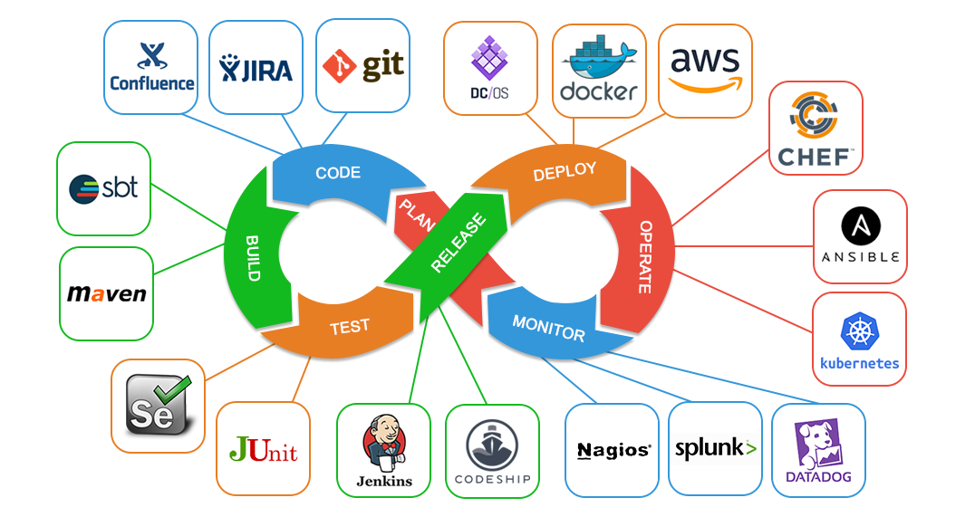
Class Roadmap - DevOps

Slide 11
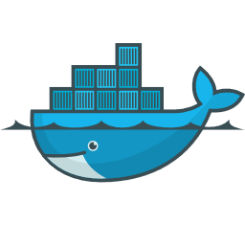
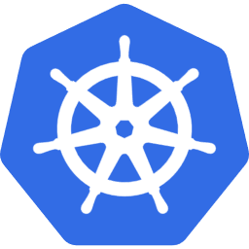
Class Roadmap
Deploy
Operate
We don’t have enough time,
and this is Cloud Computing class

Slide 12

Setting: Alpine Linux

Slide 13
Setting: Alpine Linux
Alpine Linux is an independent, non-commercial, general purpose Linux distribution designed for power users who appreciate security, simplicity and resource efficiency.
Alpine Linux is built around musl libc and busybox. This makes it smaller and more resource efficient than traditional GNU/Linux distributions. A container requires no more than 8 MB and a minimal installation to disk requires around 130 MB of storage.
https://alpinelinux.org/about/

Slide 14
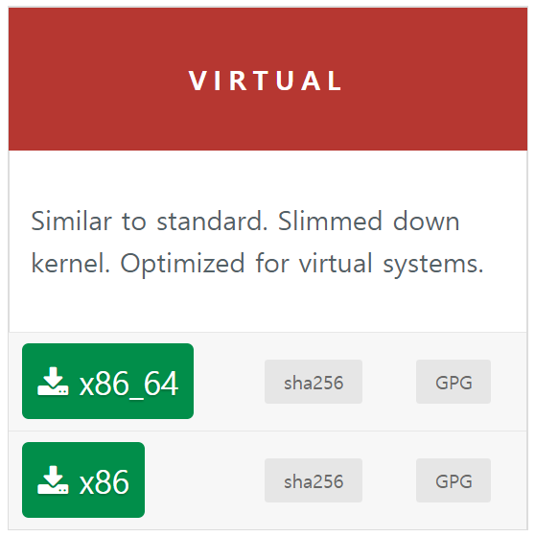
Setting: Alpine Linux
Or use mirrors
http://dl-cdn.alpinelinux.org/alpine/MIRRORS.txt
https://alpinelinux.org/downloads/

Slide 15
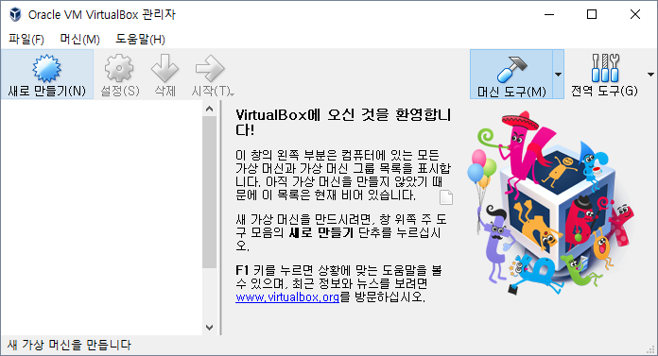
Setting: Alpine Linux
Click

Slide 16
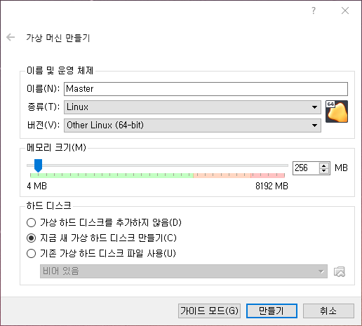
Setting: Alpine Linux
1. Select:
Type: Linux
Version: Other Linux
arch as what you downloaded
2. Select: Create new virtual hard disk now
Name and size of memory as you wanted
3. Click

Slide 17
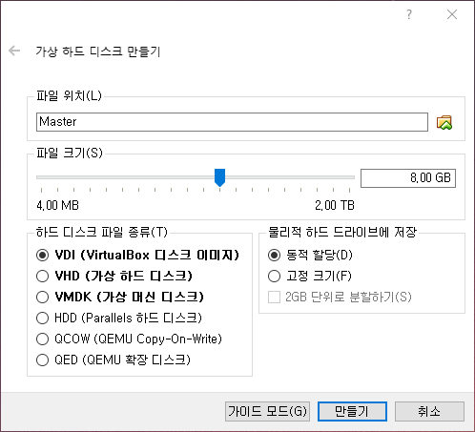
Setting: Alpine Linux
I don’t know what this is.
Using the default.
Click

Slide 18
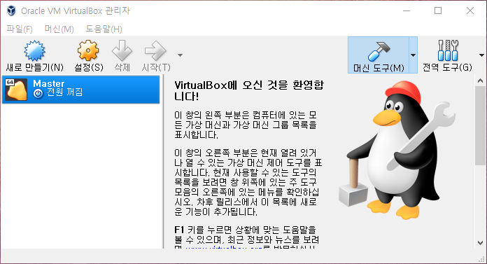
Setting: Alpine Linux
Double Click

Slide 19
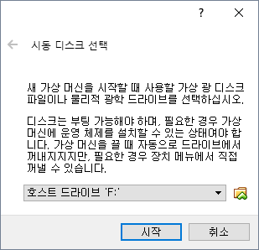
Setting: Alpine Linux
Click

Slide 20
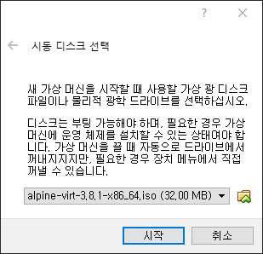
Setting: Alpine Linux
1. Select what you downloaded
2. Click

Slide 21
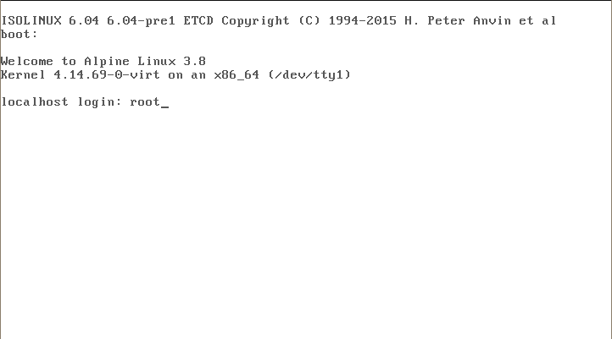
Setting: Alpine Linux
Login as root

Slide 22
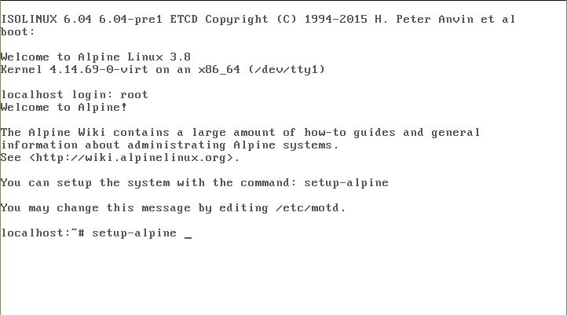
Setting: Alpine Linux
$ setup-alpine

Slide 23
Setting: Alpine Linux
Select keyboard layout [none]:
Enter system hostname … [localhost]:
Which one do you want to … [etho0]:
IP address for eth0? … [dhcp]:
Do you want to do any … [no]:
New password: 1234
Retype password: 1234
Which timezone are you in? … [UTC]:
HTTP/FTP proxy URL? … [none]:
Enter mirror number … [f]: 23
Make sure NumLock is turned on.
You should remember password.
Choose close one automatically: f

Slide 24
Setting: Alpine Linux
Which SSH server? … [openssh]:
Which NTP client to run? … [chrony]:
Which disk(s) would you … [none]: sda
How would you like to use it? … [?]: sys
WARNING: Erase the above … [y/N]: y
[opt] Proceed anyway? (y,N): y
ATTENTION
If you do wrong, just restart the VM

Slide 25
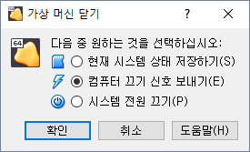
Setting: Alpine Linux
1. Select
2. Click

Slide 26
Setting: Alpine Linux
Right Click

Slide 27
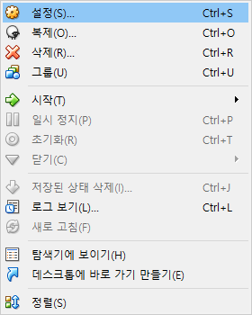
Setting: Alpine Linux
Click

Slide 28
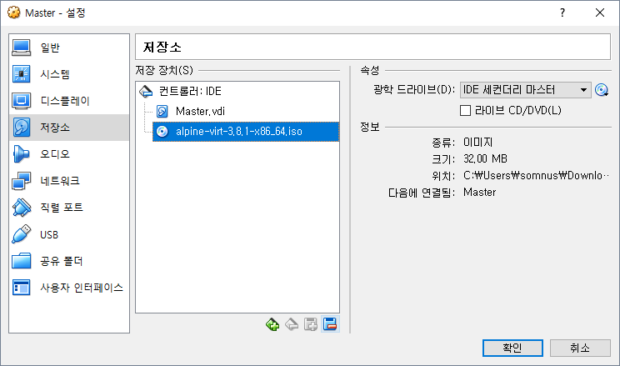
Setting: Alpine Linux
1. Click
2. Click and confirm Remove
3. Click

Slide 29
Setting: Alpine Linux
Double Click

Slide 30
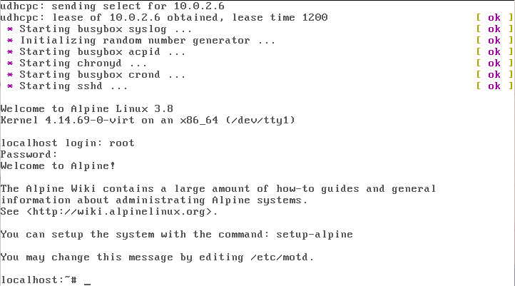
Setting: Alpine Linux
Login as root

Slide 31
Setting: Alpine Linux
$ ifconfig
eth0 Link encap:Ethernet HWaddr 08:00:27:63:79:A1
inet addr:10.0.2.15 Bcast:0.0.0.0 Mask:255.255.255.0
...
RX bytes:17368 (16.9 KiB) TX bytes:17494 (17.0 KiB)
...
$ ping korea.ac.kr
PING korea.ac.kr (163.152.6.10): 56 data bytes
64 bytes from 163.152.6.10: seq=0 ttl=42 time=10.146 ms
64 bytes from 163.152.6.10: seq=1 ttl=42 time=12.248 ms
...
7 packets transmitted, 7 packets received, 0% packet loss
round-trip min/avg/max = 1.790/12.607/19.965 ms

Slide 32
Setting: Docker
$ apk update && apk add docker
fetch http://mirrors.tuna.tsinghua.edu.cn/alpine/ ...
v3.8.1 [http://mirrors.tuna.tsinghua.edu.cn/alpine/v3.8/main]
OK: 5679 distinct packages available
ERROR: unsatisfiable constraints:
docker (missing):
required by: world[docker]

Slide 33
Setting: Docker
$ vi /etc/apk/repositories
#/media/cdrom/apks
http://mirrors.tuna.tsinghua.edu.cn/alpine/v3.8/main
http://mirrors.tuna.tsinghua.edu.cn/alpine/v3.8/community
#http://mirrors.tuna.tsinghua.edu.cn/alpine/edge/main
#http://mirrors.tuna.tsinghua.edu.cn/alpine/edge/community
#http://mirrors.tuna.tsinghua.edu.cn/alpine/edge/testing
Uncomment the community repository.
Delete as Del key
Save as :wq

Slide 34
Setting: Docker
$ apk update && apk add docker
fetch http://mirrors.tuna.tsinghua.edu.cn/alpine/ ...
fetch http://mirrors.tuna.tsinghua.edu.cn/alpine/ ...
...
OK: 9540 distinct packages available
(1/9) Installing ca-certificates (20171114-r3)
...
(8/9) Installing docker (18.06.1-r0)
Executing docker-18.06.1-r0.pre-install
(9/9) Installing docker-openrc (18.06.1-r0)
Executing busybox-1.28.4-r1.trigger
Executing ca-certificates-20171114-r3.trigger
OK: 252 MiB in 54 packages

Slide 35
Setting: Docker
$ docker version
Client:
Version: 18.06.1-ce
API version: 1.38
Go version: go1.10.1
Git commit: d72f525745
Built: Wed Sep 5 20:39:22 2018
OS/Arch: linux/amd64
Experimental: false
Cannot connect to the Docker daemon ... Is the docker daemon running?
$ rc-update add docker boot && service docker start
* service docker added to runlevel boot
* Caching service dependencies ... [ ok ]
* Mounting cgroup filesystem ... [ ok ]
* /var/log/docker.log: creating file
* /var/log/docker.log: correcting owner
* Starting docker ... [ ok ]

Slide 36
Setting: Docker
$ docker version
Client:
Version: 18.06.1-ce
API version: 1.38
Go version: go1.10.1
Git commit: d72f525745
Built: Wed Sep 5 20:39:22 2018
OS/Arch: linux/amd64
Experimental: false
Server:
Engine:
Version: 18.06.1-ce
API version: 1.38 (minimum version 1.12)
Go version: go1.10.1
Git commit: v18.06.1-ce
Built: Wed Sep 5 20:38:41 2018
OS/Arch: linux/amd64
Experimental: false

Slide 37
Setting: Etc.
$ apk add curl git
(1/7) Installing nghttp2-libs (1.32.0-r0)
...
(7/7) Installing git (2.18.0-r0)
Executing busybox-1.28.4-r1.trigger
OK: 266 MiB in 61 packages
$ curl --version
curl 7.61.1 (x86_64-alpine-linux-musl) ...
$ git --version
git version 2.18.0

Slide 38
Setting: Etc.
$ git clone \
https://github.com/KU-Cloud/hello-docker.git
Cloning into 'hello-docker'...
remote: Counting objects: 7, done.
remote: Compressing objects: 100% (6/6), done.
remote: Total 7 (delta 0), reused 7 (delta 0), pack-reused 0
Unpacking objects: 100% (7/7), done.
$ cd ./hello-docker

Slide 39
Docker: build
$ docker build –t hello:0.1 .
command
context path
option: give tag
tag
image name

Slide 40
Docker: build
$ cat ./Dockerfile
FROM node:6-alpine
WORKDIR /usr/src/app
COPY index.js package*.json ./
RUN npm install
EXPOSE 8080
CMD ["npm", "start"]

Slide 41
Docker: build
Docker can build images automatically by reading the instructions from a Dockerfile. A Dockerfile is a text document that contains all the commands a user could call on the command line to assemble an image. Using docker build users can create an automated build that executes several command-line instructions in succession.
https://docs.docker.com/engine/reference/builder/

Slide 42
Docker: history
$ docker images
REPOSITORY TAG IMAGE ID CREATED SIZE
hello 0.1 b12c48a54d09 42 minutes ago 69MB
node 8-alpine df48b68da02a 3 days ago 65.7MB
$ docker history {node image ID}
IMAGE CREATED CREATED BY SIZE
ac75c1f95b80 3 days ago /bin/sh -c #(nop) CMD ["node"] 0B
<missing> 3 days ago /bin/sh -c apk add --no-cache --virtual .bui… 4.5MB
<missing> 3 days ago /bin/sh -c #(nop) ENV YARN_VERSION=1.6.0 0B
...

Slide 43
Docker: history
$ docker history {your image ID}
IMAGE CREATED CREATED BY SIZE
b12c48a54d09 About an hour ago /bin/sh -c #(nop) CMD ["npm" "start"] 0B
cfa9be2948f7 About an hour ago /bin/sh -c #(nop) EXPOSE 8080 0B
72d445df59a4 About an hour ago /bin/sh -c npm install 3.35MB
69e216d2f92a About an hour ago /bin/sh -c #(nop) COPY multi:a940535f0516c11… 17.2kB
8c9da153728a About an hour ago /bin/sh -c #(nop) WORKDIR /usr/src/app 0B
df48b68da02a 3 days ago /bin/sh -c #(nop) CMD ["node"] 0B
<missing> 3 days ago /bin/sh -c apk add --no-cache --virtual .bui… 4.53MB
<missing> 3 days ago /bin/sh -c #(nop) ENV YARN_VERSION=1.9.4 0B
...
Note: The <missing> lines in the docker history output indicate that those layers were built on another system and are not available locally. This can be ignored.

Slide 44
Docker: Layer Concept
b12c48a54d09...
CMD
cfa9be2948f7...
EXPOSE
What we build today
hello:0.1
72d445df59a4...
RUN
69e216d2f92a...
COPY
8c9da153728a...
WORKDIR
df48b68da02a...
<missing>
node:6-alpine
...
<missing>

Slide 45
Docker: run
$ docker run -d --rm hello:0.1
command
tag
image name to run
option:
remove container when it stop
option: detach container

Slide 46
Docker: run
$ docker run -d --rm hello:0.1
cfabec52293e...
$ docker ps
CONTAINER ID IMAGE COMMAND ... PORTS NAMES
cfabec52293e hello:0.1 "npm start" ... 8080/tcp admiring_hoover

Slide 47
Docker: run
$ curl http://localhost:8080
curl: (7) Failed to connect to localhost port 8080: Connection refused

Slide 48
Docker: Network
$ docker inspect {your container ID} \
| grep IPAddress
"SecondaryIPAddresses": null,
"IPAddress": "172.17.0.2",
"IPAddress": "172.17.0.2",
$ curl http://172.17.0.2:8080
Hello Container! <br>
Total memory size of container: 238.15625 MiB

Slide 49
Docker: Network
HOST (In fact, VM on VirtualBox) 10.0.2.6
EXPOSED 8080
Container
cfabec52293e 172.17.0.2
Note: This diagram is EXTREMELY simplified.

Slide 50
Docker: Network
$ docker run -d --rm \
-p 1234:8080 hello:0.1
container port
host port
option: publish or expose container to host interface

Slide 51
Docker: Network
$ docker ps
CONTAINER ID IMAGE COMMAND ... PORTS NAMES
cfabec52293e hello:0.1 "npm start" ... 8080/tcp admiring_hoover
$ docker stop {your container ID}
$ docker ps
CONTAINER ID IMAGE COMMAND ... PORTS NAMES
$ docker run -d --rm \
–p 1234:8080 hello:0.1
A6be38ebadf0e18c5e9e90dea7207409cc12edc...

Slide 52
Docker: Network
$ curl http://localhost:1234
Hello Container!
Total memory size of container: 238.15625 MiB
Voilà!

Slide 53
Docker: Network
1234
HOST (In fact, VM on VirtualBox) 10.0.2.6
EXPOSED 8080
Container
cfabec52293e 172.17.0.2
Note: This diagram is EXTREMELY simplified.

Slide 54
Docker: Network
If you want to know more about the Docker network,
$ docker network --help
or, https://docs.docker.com/network/

Slide 55
Docker: Isolation
$ docker run -d --rm -p 1234:8080 \
-m 128MB --memory-swap -1 hello:0.1
unlimited swap
option: memory sawp limit
size of to limit
option: memory limit

Slide 56
Docker: Isolation
$ docker stop {your container ID}
$ docker run -d --rm –p 1234:8080 \
-m 128MB --memory-swap -1 hello:0.1
503ed041b548...

Slide 57
Docker: Isolation
$ curl http://localhost:8080
Hello Container!
Total memory size of container: 238.15625 MiB
Why?

Slide 58
Docker: Isolation
$ cat /sys/fs/cgroup/memory/docker/{your container ID}/memory.limit_in_bytes
134217728

Slide 59
Docker: clean up
$ docker stop $(docker ps -a -q)
$ docker rm $(docker ps -a -q)

Slide 60
Assignment 1
Write Dockerfile that assembles what we build today, but it should start from alpine:latest.
Top two layers must be CMD and EXPOSE instruction.
You can use following code:
RUN apk add nodejs
RUN apk add npm
RUN npm install
You must describe each line of Dockerfile you wrote in DETAIL.
You do not need to use COPY instruction. (optional)
Minimize layers of your image. (optional)
I think 5 is minimum.
Submit your Dockerfile

